Slide 1



Walmart sales report
View in Power BI
Last data refresh:
3/14/2023 3:35:32 PM UTC
Downloaded at:
3/14/2023 3:42:23 PM UTC

Slide 2
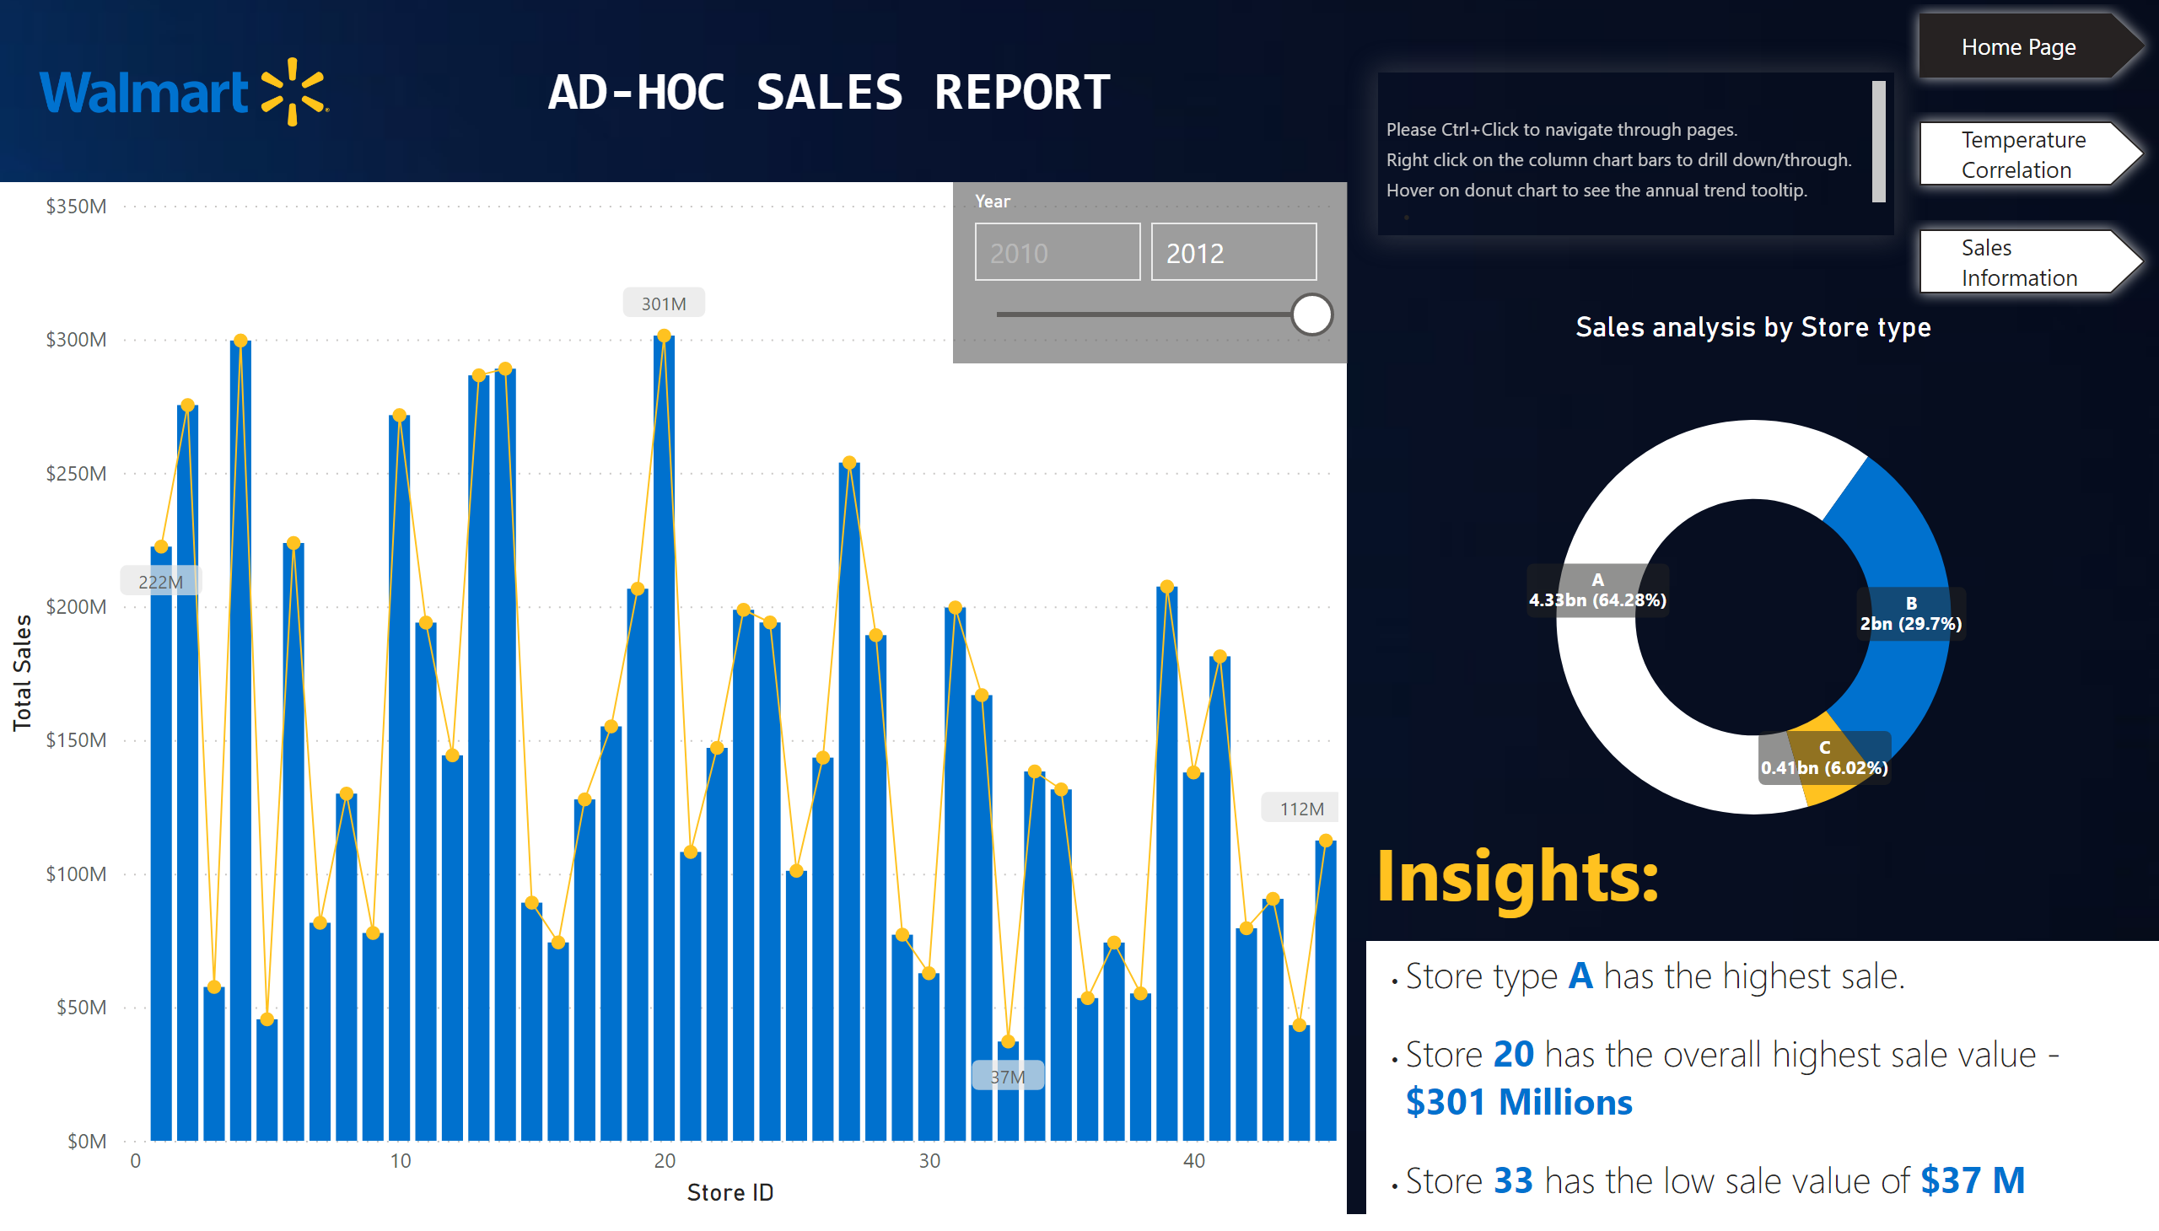
Home Page
Notes:
lineClusteredColumnComboChart
No alt text provided
image
No alt text provided
Sales analysis by Store type
No alt text provided
slicer
No alt text provided
textbox
No alt text provided
pageNavigator
No alt text provided
textbox
No alt text provided
textbox
No alt text provided
textbox
No alt text provided

Slide 3
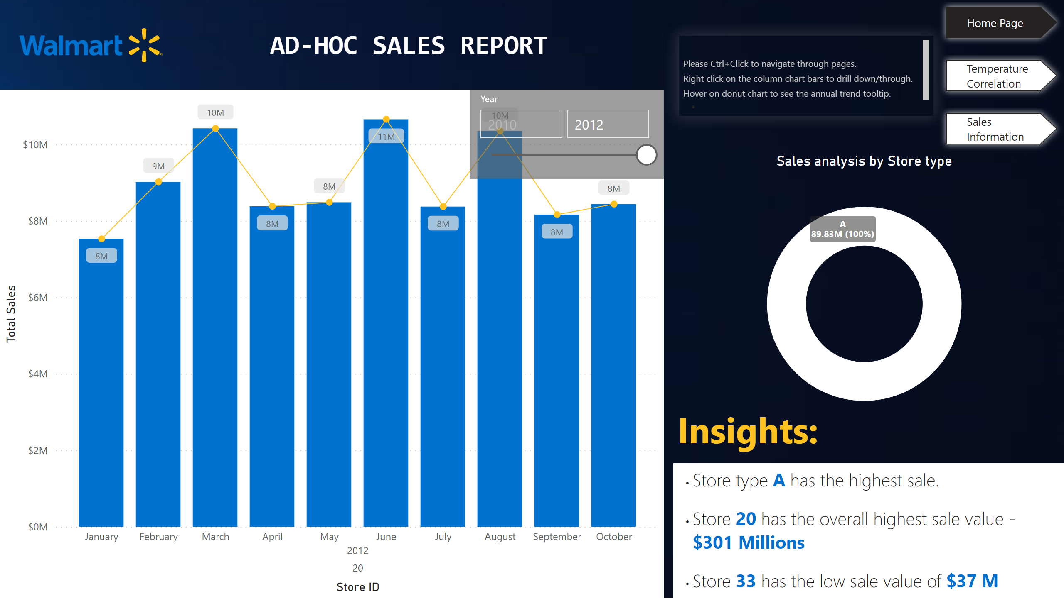
Home Page
Notes:
lineClusteredColumnComboChart
No alt text provided
image
No alt text provided
Sales analysis by Store type
No alt text provided
slicer
No alt text provided
textbox
No alt text provided
pageNavigator
No alt text provided
textbox
No alt text provided
textbox
No alt text provided
textbox
No alt text provided

Slide 4
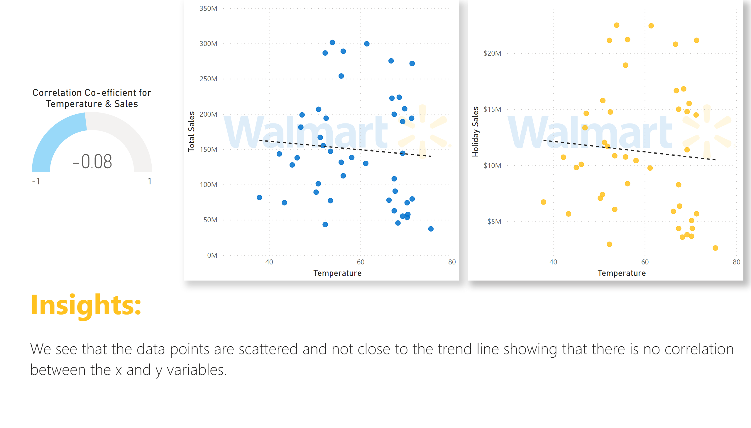
Temperature Correlation
Notes:
scatterChart
No alt text provided
Correlation Co-efficient for Temperature & Sales
No alt text provided
scatterChart
No alt text provided
textbox
No alt text provided
textbox
No alt text provided

Slide 5
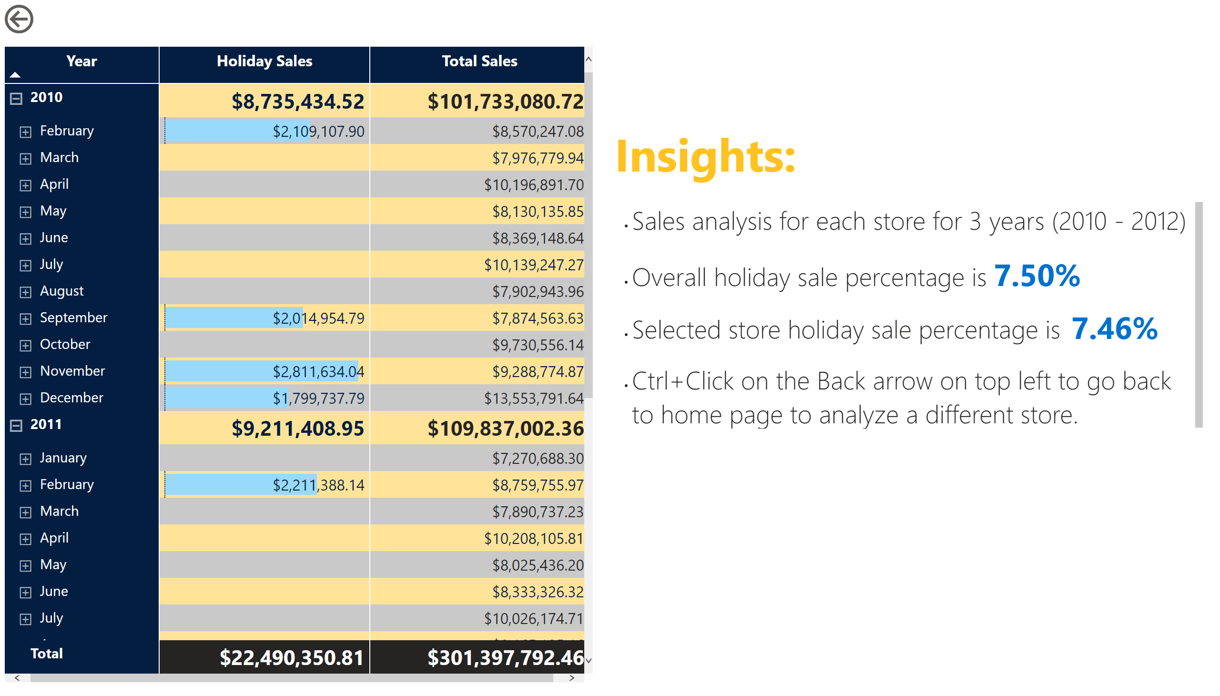
Sales Information
Notes:
pivotTable
No alt text provided
card
No alt text provided
textbox
No alt text provided
textbox
No alt text provided
actionButton
No alt text provided

